Slide 1
An introduction to Azure SQL managed databases
Azure SQL Database Azure SQL Managed Instance

Slide 2

Today’s data realities
02-01.01
3
What data do I have?
Data governance
Is it trustworthy?
2
Can people access the data needed to make the right decisions?
Analytics
1
How can I enable faster business insights?
Operational databases
What’s my compliance exposure?
Notes:
If there’s one thing that 2022 has taught us is that data is truly the strategic asset for businesses today.
During this time of uncertainty, one thing we’ve observed is that no business is immune to sudden changes. Navigating this new landscape requires a new level of agility for businesses to deal with sudden changes in our world.
And what we’ve observed is that those that can accelerate innovation and embrace their data as a strategic asset have fared better.
They have established the culture and capabilities needed to be more agile, able to anticipate and predict disruptions and pivot as needed to better serve their customers.
The stakes are high and an organization’s growth prospects ultimately depend on data at its core.
Doing this isn’t easy, given the realities of data today. The volume, variety and velocity of data are all accelerating dramatically, and the complexity of creating of an enterprise ‘knowledge graph’ can seem insurmountable. Today we generate data far faster than we are able to understand it
In fact, IDC predicts that by 2025, just 5 years from now, the world’s data will climb to 175 zettabytes. To put that in perspective, if you were to store that data in a stack of BluRay discs you’d be able to go to the moon and back 23 times!
Without the right people, processes and capabilities in place, it can be difficult to answer fundamental questions like:
What data do I have?
Is it trustworthy?
Are people getting the data they need to make the right decisions?
Are they getting it fast enough?
And are we managing data in a compliant way?...

Slide 3

Introducing Microsoft Intelligent Data Platform
02-01.02
3
Data governance
2
Analytics
1
Operational databases
Microsoft Intelligent Data Platform
SQL Server • Azure SQL • Azure Cosmos DB • Azure Synapse Analytics
Power BI • Microsoft Purview • Azure AI
Operational databases | Analytics | Data governance
Notes:
Getting the right answers to these questions is possible when all your data assets are connected and managed in a cohesive fashion. This is why we announced the Microsoft Intelligent Data Platform, the leading cloud data platform that empowers organizations to invest more time creating value rather than integrating and managing their data estate.
The platform is made up of capabilities across databases, analytics and governance that, on their own, meet specific business needs and already bring many benefits but together helps easily evolve applications to include advanced analytics and intelligence. It is the integration of the products you are already using today to accelerate innovation and achieve agility, across our cloud, as well as others
We want to remove key points of friction between your databases and analytics systems while ensuring your full data estate can be automatically mapped and governed
Organizations can analyze large volumes of operational data in near real-time with no extraction, transformation, or loading (ETL) pipelines, and no performance impact on transactional workloads
And anyone in the organization, whether they’re a data scientist, data analyst or a domain expert, can access, analyze, and share data
This is the state we are all aiming for is where we can:
Accelerate innovation, Focus on what matters most – your business. Free resources to create frictionless customer experiences, transform products and empower employees.
Achieve agility, Pivot faster to respond to dynamic environments with an integrated data platform that adapts to your needs with hybrid and multi cloud capabilities. Build how you want, deploy where you want and gain fast, continuous insights.
Build on a trusted platform, Deliver data-powered experiences with the security and privacy controls required to innovate with confidence. Azure provides the most comprehensive protection for your valuable business data.

Slide 4
Transform with the Microsoft Cloud
02-04.05
2
Microsoft Cloud
Dynamics 365 • Microsoft 365 Power Platform
1
2
3
Microsoft Intelligent Data Platform
SQL Server • Azure SQL • Azure Cosmos DB • Azure Synapse Analytics
Power BI • Microsoft Purview • Azure AI
Operational databases
Analytics
Data governance
Operational databases | Analytics | Data governance
Notes:
We're also integrating The Intelligent Data Platform with the rest of the Microsoft Cloud, for enabling richer data experiences for business users of Microsoft 365 and Dynamics 365 and Power Platform.
The first step for a successful digital transformation is often data modernization. Migrating and modernizing your databases allows you to focus on your application, not your database. You no longer have to worry about scaling your applications to meet high demand, security and management is made simple, and you’re always up to date with the latest and greatest database features, irrespective of whether you prefer proprietary or open source databases.

Slide 5
Industry Findings Predict Continued Migration and Modernization Momentum
27%
59%
72%
projected growth in cloud-based IT spend in 2021
Of organizations responded that migrating more workloads to the cloud is a top Cloud Initiative for 2021*
of organizations reported industry’s pace of transformation has been accelerating as a result of the pandemic
90%
23%
80%
of existing apps will still be in use, cloud modernization top benefit
Growth in end user spend on public cloud computing to $332B**
of enterprises will have the mechanism in place by the end of 2021 to shift to cloud-centric infrastructure and applications, 2X as fast as before the pandemic
Source: Gartner reports and public articles | *Source: Flexera State of the cloud 2021 | **Gartner Press Release: Gartner Forecasts Worldwide Public Cloud End-User Spending to Grow 23% in 2021

Slide 6
Migration and modernization triggers
Cash flow challenges
Cybersecurity threats
Datacenter contract expiry
Budget and resource constraints
Migration
Modernization
Rapidly scale web apps and infrastructure
Enabling remote work
Faster time to market
Drive Innovation
Unlocking more cost optimization
Notes:
These are the typical triggers that are making customers look at cloud identity during these challenging times.
Common ones include:
Cash flow challenges – This includes cash flow challenges not just for our customers, but also their entire ecosystem (e.g., suppliers, distributors, end customers).
Cybersecurity threats – Customers are feeling more vulnerable to attackers, their defenses are down
Scarce IT budgets/resources – Customers are reporting the need to free up IT $s to invest into other parts of the business that may need it more
Ability to meet surge demand – Several industries such as healthcare, retail are seeing a surge in demand. They are finding that their existing systems and solutions just can’t keep up.
Business continuity – Customers have real concerns about their day to day operations being interrupted (e.g., network connectivity, data loss)
Datacenter contract expiry – Many customers we speak to are viewing contract expiry as an inflection point to consider cloud migrations (“is it worth running my own given resource/cash flow challenges”?)

Slide 7
Why should customers migrate and modernize to Azure?
Migration
Modernization
Enterprise-grade Infrastructure for less
Innovate faster with a fully managed platform
Move on your terms with hybrid flexibility
Protect your most valuable assets with trusted cloud security every step of the way
Comprehensive programs to help you move with confidence
Notes:
Pay less, use best-in-class infrastructure:
Future proof your business and IT – be it remote workforce productivity or on-demand scale – by moving to best-in-class, highly resilient cloud infrastructure that costs up to 5x less than AWS
Innovate faster by modernizing your applications and data:
Focus on modernizing your application and workload portfolio to meet business demands of today and tomorrow. Use a highly productive platform and fully managed services – we take care of the operational work for you
Move on your terms with hybrid flexibility:
We get that your investments will span cloud and on-premises for the foreseeable future. Azure hybrid cloud solutions help you reuse, manage, and govern your assets consistently across hybrid environments as you move to the cloud (and beyond) - on your terms.
Protect your valuable assets with trusted cloud security:
We have your back. Get security from the ground up – backed by experts and proactive compliance. With AI-infused security intelligence, we help you detect and protect your investments against rapidly evolving cybersecurity threats.

Slide 8
Be future-ready with Azure
A.I.
Intelligent by default
Scale
Limitless
Hybrid
Operational freedom
Security
Always a step ahead
Notes:
Microsoft Azure is the cloud that lets you turn ideas into solutions with more than 100 services to build, deploy, and manage applications—in the cloud, on-premises, and at the edge—using the tools and frameworks of your choice. Our track record of continuous innovation supports your development today and your visions for tomorrow. Over the past year, we’ve launched over 1000 capabilities on the platform, helping our customers be future-ready. The cloud is moving fast – every week a new technology is coming out. So it’s about meeting new capabilities now and investing in those on the horizon.
In the world of data, we are committed to empowering organizations to build on their terms with flexibility and choice, and that includes the freedom to operate anywhere.
Nothing is more important than trust, particularly when you’re talking about the cloud. We spend $1B a year on cyber security with 3500 cyber security engineers who are constantly monitoring your data for threats. We’ve invested ahead of the curve in layers of security with built-in controls to protect your data and close the gaps that attackers can exploit. Trust your workloads to Azure, built upon the most secure cloud with the broadest compliance coverage.
Break through the resource constraints of modern application development with limitless scale that goes far beyond other cloud providers.
Modernize existing apps or build new apps on Azure with built-in, AI-based technologies that power new customer experiences.
Azure can help you innovate today, tomorrow, and in the future. We are constantly providing capabilities that can help meet your needs.

Slide 9




Azure SQL
The family of SQL cloud to edge databases
SQL Server on Azure Virtual Machines
Azure SQL Managed Instance
Azure SQL Database
Azure SQL Edge
Best for lift and shift and/or workloads requiring OS-level access
Best for modernizing existing apps
Best for supporting modern cloud apps
Best for extending apps to IoT edge
Infrastructure-as-a-Service
Platform-as-a-Service
Edge Computing
Azure SQL enabled by Azure Arc
Run Azure SQL on premises and in multicloud environments
Azure is the cloud that knows SQL Server best
Notes:
Azure SQL, part of the Microsoft Intelligent Data Platform, is a family of fully-managed, secure and intelligent SQL database services. Azure offers the widest range of deployment options for SQL from edge to cloud. With Azure SQL, you can rehost SQL workloads on SQL Server on Azure Virtual Machines, modernize existing applications with Azure SQL Managed Instance and support modern cloud applications with Azure SQL Database and Azure SQL Edge.
Azure SQL is built upon the same SQL Server engine, so you can migrate applications with ease and continue to use the tools, languages and resources you’re familiar with. Your skills and experience transfer to the cloud and edge, so you can do even more with what you already have.
The services within Azure SQL support a variety of scenarios:
SQL Server on Azure Virtual Machines
Lift-and-shift your SQL workloads with ease and maintain with 100% SQL Server compatibility and operating system-level access
Azure SQL Managed Instance
Modernize your existing SQL Server applications at scale with an intelligent fully managed service
Azure SQL Database
Support modern cloud applications on an intelligent, managed service that includes serverless compute
Azure SQL Edge
Run IoT edge compute with a SQL database optimized with data streaming, time series, and AI capabilities built-in
SQL Server on Azure VMs and SQL Managed Instance are also now Azure Arc enabled, allowing you to run these services on the infrastructure of your choice, when a hybrid approach is required.

Slide 10

Azure SQL provides more price-performance value
Azure SQL Managed Instance vs SQL Server on AWS RDS
MSOLTPE Benchmark
April 2022
SQL Server on Azure VM vs SQL Server on AWS EC2
Transactional Field Test Benchmark
April 2022
93% LESS
31% LESS
Price/Transactions per second (tps)
Price/Transactions
Price performance comparison. Lower is better.
Includes Azure Hybrid Benefit
Price performance comparison. Lower is better.
Includes Azure Hybrid Benefit and 3-yr commitment
Source: Principled Technologies
Source: GigaOm
Notes:
You can also get more for performance for your money on Azure SQL.
Azure SQL provides more value through leading price-performance. A recent report from Principled Technologies, an independent research firm, concluded the following:
Azure SQL Database meets your mission-critical requirements up to 5 time faster while costing up to 93% less than SQL Server on AWS RDS.¹
SQL Server on Azure Virtual Machines has up to 42% higher transactions per second and costs up to 31% less than SQL Server on AWS EC2.²
¹ Price-performance claims based on data from a study commissioned by Microsoft and conducted by Principled Technologies in April 2022. The study compared performance and price performance between a 16 vCore, 64 vCore and 80 vCore Azure SQL Managed Instance using premium-series hardware on the business-critical service tier and the db.m6i.32xlarge, db.r5b.4xlarge and db.r5b.16xlarge offerings for Amazon Web Services Relational Database Service (AWS RDS) on SQL Server. Benchmark data is taken from a Principled Technologies report using recognized standards, HammerDB TPROC-C, HammerDB TPROC-H and Microsoft MSOLTPE, a workload derived from TPC-E. The MSOLTPE is derived from the TPC-E benchmark and as such is not comparable to published TPC-E results, as MSOLTPE results do not comply with the TPC-E Specification. The results are based on a mixture of read-only and update intensive transactions that simulate activities found in complex OLTP and analytics application environments. Price-performance is calculated by Principled Technologies as the cost of running the cloud platform continuously divided by transactions per minute or per second throughput, based upon the standard. Prices are based on publicly available US pricing in South Central US for Azure SQL Managed Instance and US East for AWS RDS as of April 2022 and incorporates Azure Hybrid Benefit for SQL Server, excluding Software Assurance and support costs. Performance and price-performance results are based upon the configurations detailed in the Principled Technologies report. Actual results and prices may vary based on configuration and region.
² Price-performance claims based on data from a study commissioned by Microsoft and conducted by GigaOm in April 2022. The study compared price performance between SQL Server 2019 Enterprise edition on Windows Server 2022 in Azure E32bds_v5 instance type with P30 Premium SSD disks and SQL Server 2019 Enterprise Edition on Windows Server 2022 in Amazon Web Services Elastic Cloud Compute instance type r5b.8xlarge with General Purpose (gp3) volumes. Benchmark data is taken from two tests:
The GigaOm Transactional Field Test derived from a recognized industry standard, TPC Benchmark™ E (TPC-E).The Field Test does not implement the full TPC-E benchmark and as such is not comparable to any published TPC-E benchmarks.
The GigaOm Analytics Field test derived from the TPC-H Benchmark. The field test does not implement the full TPC-H benchmark and as such is not comparable to any published TPC_H benchmarks.
Prices are based on publicly available US pricing in North Central US for SQL Server on Azure Virtual Machines and Oregon for AWS EC2 as of April 2022. The pricing incorporates three-year reservations for Azure and AWS compute pricing, and Azure Hybrid Benefit for SQL Server and Windows Server, and License Mobility for SQL Server in AWS, excluding Software Assurance and support costs. Actual results and prices may vary based on configuration and region.

Slide 11
Managed solutions that do more for you
SQL Server on Azure VMs
Azure SQL Managed Instance
Azure SQL Database
Azure SQL
Edge*
Intelligent performance/security
Intelligent performance/security
Intelligent performance/security
Managed by customer
Applications
Applications
Applications
Applications
Managed by Microsoft
Data
Data
Data
Data
Machine learning capability
*in connected scenario
Database
Database
Database
Database
SQL instance-level features
SQL instance-level features
High Availability /DR/Backups
High Availability/ DR/Backups
High Availability/ DR/Backups
High Availability/ DR/Backups
Database provision/ Patch/Scaling
Database provision/ Patch/Scaling
Database provision/ Patch/Scaling
Database provision/ Patch/Scaling
Operating system
Operating system
Operating system
Operating system (container)
Virtualization
Virtualization
Virtualization
Container Platform
Hardware
Hardware
Hardware
Hardware & Operating System
Datacenter management
Datacenter management
Datacenter management
Device management (IoT Hub)

Slide 12
Azure SQL
Azure SQL Database and Azure SQL Managed Instance
Streamline app modernization
Hyperscale demanding workloads
Optimize price-performance with serverless compute
Build modern, intelligent apps faster
Save with the best total cost of ownership
Accelerate app modernization with minimal code changes on the only cloud with evergreen SQL
Rapidly adapt to changing requirements with Hyperscale storage up to 100 TB
Reduce management complexity with flexible, auto-scaling serverless compute. Pay only for what you use.
Build modern apps with multi-model capabilities and support for the most popular languages and frameworks.
Meet mission critical requirements while costing up to 86% less than the competition
Built-in AI
Advanced data security
Always On reliability
Optimizes performance and durability for you
Secure your data with layers of protection, built-in controls and leading compliance
Maximize uptime with built-in high availability and an industry-leading availability SLA up to 99.995%
Notes:
Azure SQL Database and Azure SQL Managed Instance are fully-managed services that are always up to date with the latest features, updates and patches so you can focus more on developing great experiences for your customers instead of managing infrastructure and software. Our most recent investments provide the highest SQL Server on-premises application compatibility, remove the limits to application growth and help you cost-optimize your compute spend.
With Azure SQL Managed Instance, we’re streamlining app modernization by providing the full SQL Server programming surface area in the cloud, eliminating the need for code changes and providing the tools and environment DBAs are familiar with.
Break through the resource limitations that can affect your application’s performance. Azure SQL Database Hyperscale adapts to changing requirements by rapidly scaling storage up to 100 TB. Flexible, cloud native architecture allows storage to grow as needed and enables nearly instantaneous backups and fast database restores in minutes—regardless of the size of the data operation.
Optimize costs and build modern apps your way with flexible compute options that include serverless. Azure SQL Database serverless simplifies performance management and helps developers focus on building apps faster and more efficiently with compute resources that automatically scale based on workload demand. SQL Database serverless is best for scenarios where usage is intermittent and unpredictable and you only pay for compute resources you use on a per-second basis, optimizing overall price-performance.
You have the freedom to choose relational, graph or JSON data models and still have the guarantee of high performance and scalability that comes with Azure SQL Database. Everything is powered by a smart query optimizer that allows you to mix and match any feature, providing flexibility and development velocity at the same time.
Switch to Azure SQL Database and save with the best total cost of ownership. Azure SQL Database meets your mission-critical requirements while costing up to 86 percent less than the competition. Unique offers like Azure Hybrid Benefit for SQL Server maximize the value from your current licensing investments. Use your SQL Server licenses with Software Assurance and save up to 55 percent over pay-as-you-go pricing.
Our managed services are all built on a foundation of trust, reliability and productivity, securing your data with layers of protection and built-in controls, maximizing uptime with up to 99.995% availability and optimizing performance and durability on your behalf.

Slide 13



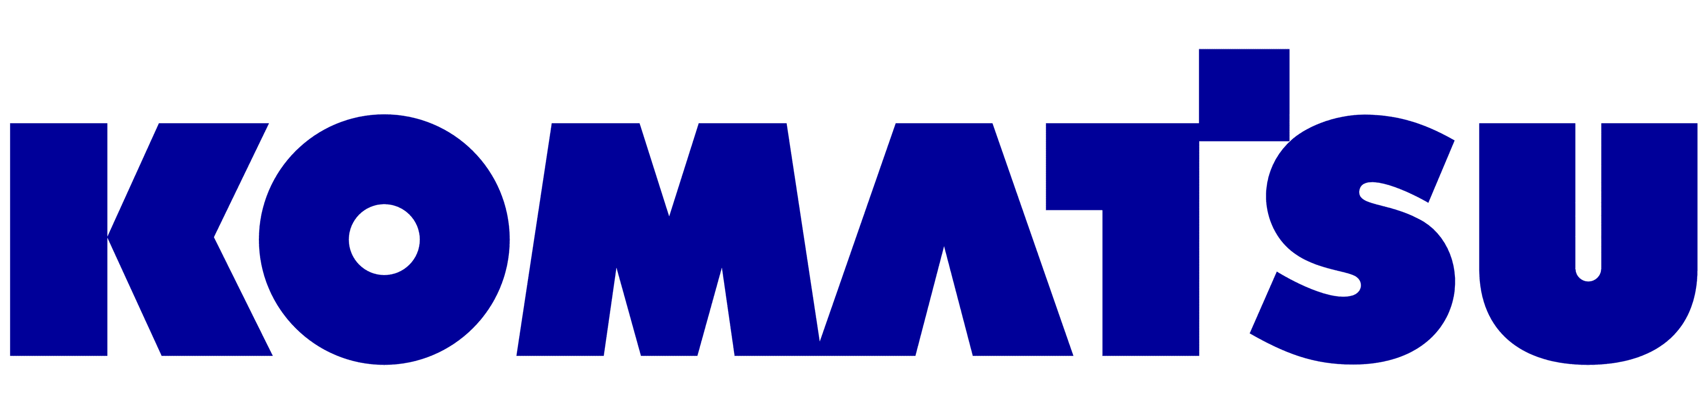

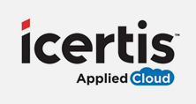
Key use cases (1 of 2)
Modernization in the cloud for efficient business operations
Modernization of legacy .NET apps to streamline development and deliver rich experiences
Optimize costs of unpredictable and intermittent workloads



We determined [Azure SQL Managed Instance] was the best choice for us in terms of scalability, cost, and performance.… We’ve seen a 49 percent cost reduction and 25 to 30 percent performance gains.”
Nipun Sharma, Analytics Architect, Business Technology and Systems
Nobody understands .NET and SQL Server better than Microsoft, which, through Azure, gave us a robust set of managed services for migrating our legacy applications to the cloud.”
Bev Kite, Chief Information Officer
We’ve realized three major benefits. One: We only pay for what we use. Two: relying on serverless automatic scaling instead of our own home-grown solution frees more time for innovation. And three: It helps our customers always get the right performance levels they need, day or night.”
Purna Rao, Senior DevOps Architect
Notes:
Let’s look at some of our customers who have modernized their workloads to Azure or are building new applications - and reaping the benefits:
KOMATSU (https://customers.microsoft.com/en-us/story/komatsu-australia-manufacturing-azure)
Situation:
Komatsu builds and sells a lot of heavy equipment, but the company knows that it takes more than machines to be successful. They had multiple mainframe applications for different types of data and needed to consolidate them into a single system so that different parts of the organization could easily get a holistic view of data from different sources. They had 1.5 terabytes of data and growing, and were processing around a million records per day.
Solution:
After evaluating available deployment options, the company chose Azure SQL Managed Instance to optimize performance for its large volumes of data.
Impact:
In less than two weeks, Komatsu moved their entire database to SQL Managed Instance and saw a 49% cost reduction and 25-30% performance gain.
ACADEMY OF MOTION PICTURE ARTS AND SCIENCES (https://customers.microsoft.com/en-us/story/845185-academy-motion-picture-arts-sciences-media-entertainment-azure)
Situation:
Much of the Academy’s information existed on paper or in isolated on-premises databases and leadership was concerned their on-premises infrastructure would not be able to keep up with their aggressive growth plans.
Solution:
To streamline its development and better serve its membership, the Academy migrated its infrastructure to the cloud, first moving it main SQL Server database into Azure SQL, then moving their most important ASP.NET web app into Azure App Service.
Impact:
With Azure, the Academy was able to migrate its legacy web applications to the cloud and deliver its new streaming applications quickly, safely, and cost-effectively, with minimal code changes.
ICERTIS (https://customers.microsoft.com/en-us/story/781602-icertis-partner-professional-services-azure)
Situation:
Icertis, which provides industry-leading cloud-based contract management software, experienced spikes in customer workloads. It was challenging to predict demand and quickly rescale compute power to meet it—driving up costs and complexity.
Solution:
With the Microsoft Azure SQL Database serverless compute tier, Icertis can automate almost instant rescaling of database and compute resources to meet customer workload demands. It only pays for the power its customers need, and DevOps employees now focus on high-value initiatives.
Impact:
Icertis has reduced individual database costs by up to 70 percent, reduced operational complexity, and improved service fidelity, performance, and availability.

Slide 14
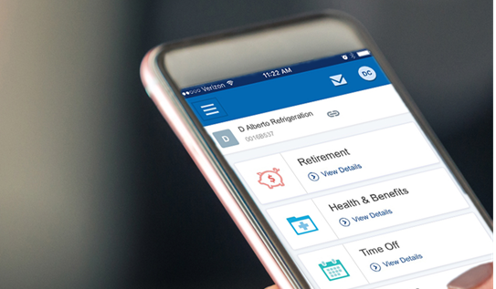





Key use cases (2 of 2)
Multi-tenant SaaS app development
Enable future growth with near limitless storage
Migration from IaaS to PaaS to lower costs and open the door to AI and machine learning



The Platform as a Service capabilities of Azure have allowed us to get the benefits of Microsoft technologies without the overhead.”
Dave Wilson: Sr. Director of IT Infrastructure and Architecture
Working in the Azure SQL Database Hyperscale tier helps us streamline upgrades to new and existing applications, and with instant, unlimited scaling, customers can rely on us when it counts.”
Jelther Gonçalves, Data Engineer
We’re reconfiguring our environment to move from IaaS to a PaaS model, so that we can really take advantage of cost savings around infrastructure maintenance, upgrades, app installs, all of those things that are going to now be automated.”
Kristina Wilson, IT Manager, Client Applications
Notes:
PAYCHEX (https://customers.microsoft.com/en-us/story/paychex-azure-sql-database-us)
Situation:
Paychex is a human capital management firm with tremendous reach. Data for their Flex Time app was maintained on-premises, but managing that environment became very cumbersome as customer volume grew.
Solution:
Paychex migrated their customer’s data to SQL DB, placing each into a separate database, which were then organized into elastic pools, which share resources at a set price, optimizing costs across DBs with different performance needs
Impact:
Today, tens of thousands of customers are hosted on Azure, with triple-digit growth YoY. And that number isn’t slowing down—it’s accelerating. Paychex engineers are freed from managing infrastructure, licensing, and database spin up and spin down.
CLEARSALE (https://customers.microsoft.com/en-us/story/773410-clearsale-partner-professional-services-azure)
Situation:
ClearSale helps major brands identify fraudulent transactions on their e-commerce sites. But its on-premises platform had become increasingly difficult to scale for customer growth or peak shopping demand.
Solution:
ClearSale needed to migrate its platform, applications, and databases to the cloud and chose the Microsoft Azure SQL Database Hyperscale service tier, Azure Event Hubs, and Azure Functions to achieve greater scalability and flexibility.
Impact:
Since beginning its migration and building a new cloud-based fraud prevention platform, ClearSale can now process virtually an infinite number of transactions a minute with automatic scaling to accommodate organic growth and spikes in transaction rates or volumes.
H&R BLOCK (https://customers.microsoft.com/en-us/story/724156-hr-block-professional-services-azure-sql-server)
Situation:
H&R Block is working to offer seamless client experiences and wanted to simplify data collection, access, and analysis. H&R Block needed to unite a set of disparate data stores spread across multiple legacy database technologies.
Solution:
As part of a multi-phase migration initiative, H&R Block is migrating the data tier of all its applications to Azure data services, which includes Azure SQL Managed Instance.
Impact:
H&R Block has been able to enhance service delivery, scale to meet its peaks in demand, and accelerate innovation through AI-based technology.

Slide 15
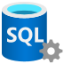

Select the path that is right for your workloads
Offramps to IaaS exist for key scenarios
Highway to PaaS
Azure SQL PaaS
SQL Server on-premises
Why IaaS?
Why PaaS?
Legacy workloads
Easy lift-and-shift to IaaS eliminates the need for rearchitecting or refactoring
No end of support hassles
Always up to date, never out of support, with backwards compatibility to SQL Server 2008
Time constraints
Lift-and-shift to IaaS leverages existing on-premises skillsets
Does more on your behalf
Automated and AI-powered features enhance performance and security for you
Offramps to IaaS
SQL Server on Azure Virtual Machines
Reliance on non-PaaS offerings
IaaS can adhere to on-premises standards
Fully managed SQL Server instance
Broadest SQL Server compatibility with the benefits of a fully managed, integrated service
Business critical data
Maintain OS-level control to customize manageability and security
Built-in HA and automatic
Provides automated backups, auto-failovers and up to 99.995% SLA
To keep pace in a changing tax industry, H&R Block wanted to unify its disparate data sources so the company could deliver more seamless multichannel experiences and provide better service for its customers.
Phase 1 – Lift and shift to Azure SQL IaaS
Migration expediency in limited time window
Maintain OS-level control
Perceived initial lower risk than a direct PaaS migration.
Phase 2 – Modernize on Azure SQL PaaS
Cost optimization through eliminated infra and reduced admin costs
Improved productivity through automated features
Accelerate time to market through CI/CD and DevOps processes
AI and machine learning support ongoing innovation and customer value
“SQL [Managed Instance] gives us a smooth migration path for moving existing workloads to Azure with minimal technical reengineering.”
Sameer Agarwal, Manager, Enterprise Data Analytics, H&R Block
* “Azure SQL Purchase Journey and Audience Mindset” customer research with ITDM/DBA/DevOps audience, Dec 2020

Slide 16
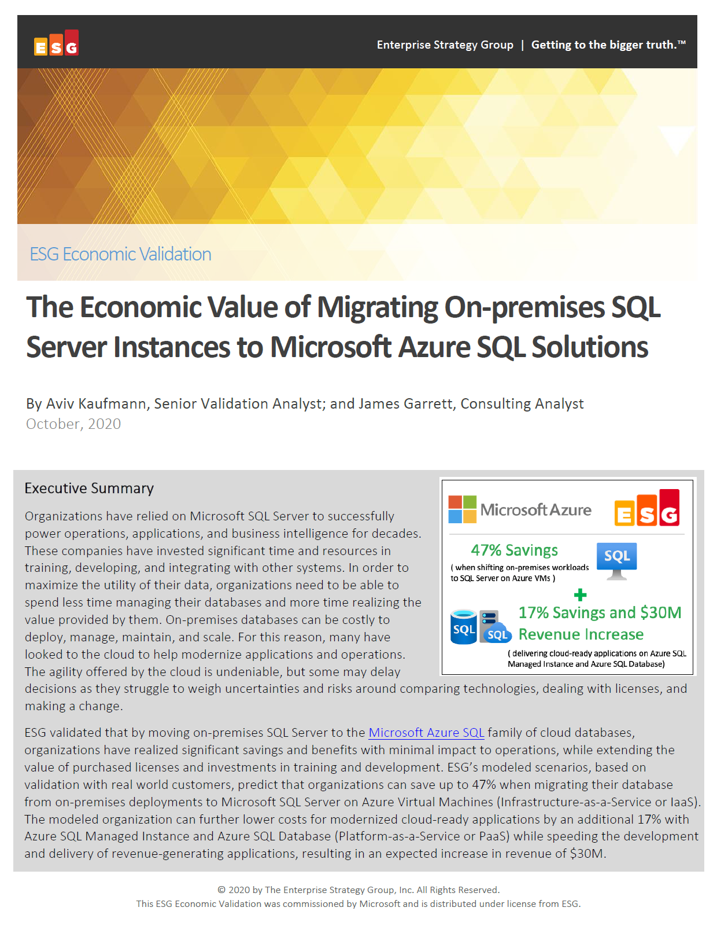
Migrate to IaaS, continue to PaaS and boost your ROI
Enterprise Strategy Group examined potential cost savings and business benefits enterprises would achieve from migrating on-premises workloads to Azure SQL, first to IaaS then to PaaS.
Modernizing on Azure SQL yields even greater benefits…
Key report benefits and findings¹
+17%
Additional cost savings on Azure SQL managed databases vs Azure SQL VMs
53%
Lower cost of application administration
Up to 47%
Cost savings on Azure SQL VMs vs on-premises SQL Server
90%
Lower cost of systems administration
+$30M
Additional revenue due to faster time to market
¹ Results are based on interviewed customers. “The Economic Value of Migration On-premises SQL Server Instances to Microsoft Azure SQL Solutions,” a commissioned study conducted by The Enterprise Strategy Group on behalf of Microsoft, October 2020.
Notes:
The previous stories are just a sample of the types of scenarios that Azure SQL supports – and the benefits customers have experienced when choosing Azure SQL.
Enterprise Strategy Group recently published a commissioned study that looked at the potential savings and operational benefits of migrating from on-premises to Azure SQL, first to IaaS and then continuing to PaaS.
ESG saw that modernizing on Azure SQL’s managed databases provided an incremental +17% cost savings vs Azure SQL VMs, but also significant reductions in app and systems administration costs.
The benefits of fully-managed services are compelling, but ultimately you need to decide which Azure SQL options are right for you.

Slide 17
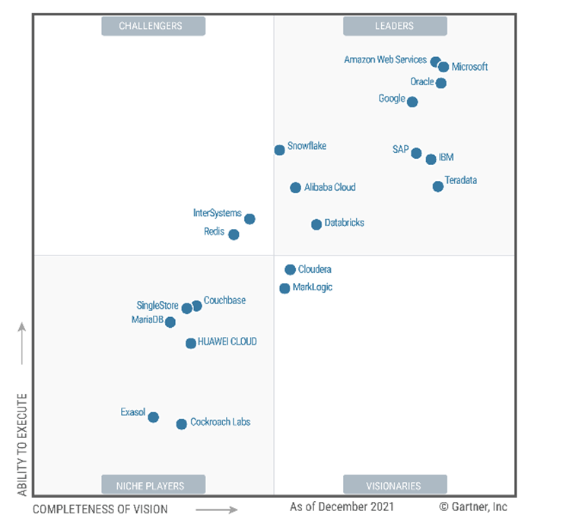
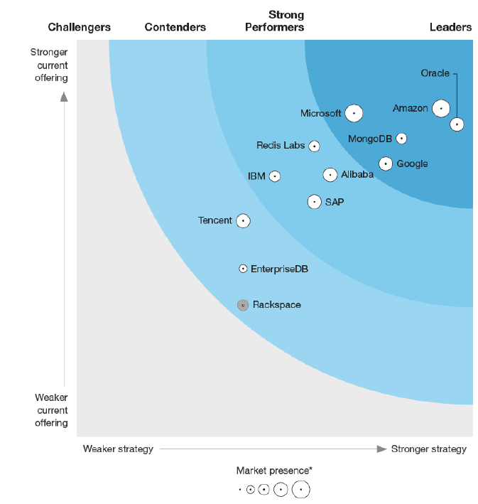
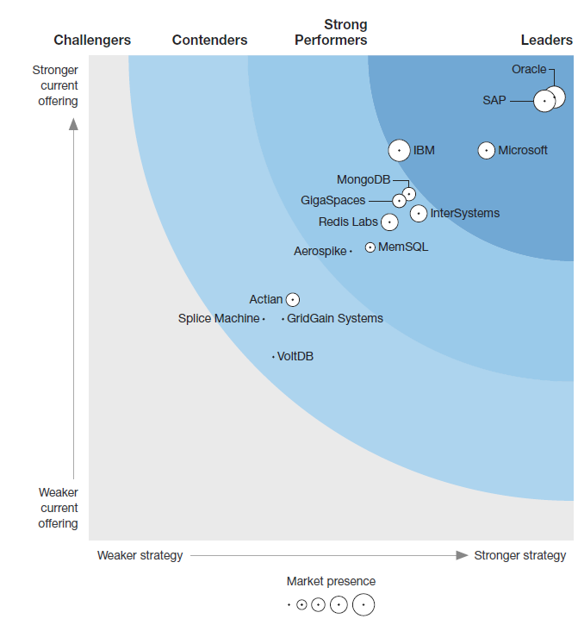
Azure SQL Database is a recognized leader
A leader for 2 consecutive years
Gartner® Magic QuadrantTM
Forrester WaveTM:
Forrester WaveTM:
Cloud Database Management Systems December 2021¹
Database-as-a-Service, Q2 2019²
Translytical Data Platforms Q4 2019³
According to Gartner:
“Microsoft offers a comprehensive cloud data management ecosystem that spans all the use cases evaluated for this Magic Quadrant.”
According to Forrester:
“Microsoft offers a mature, scalable, secure, and hybrid DBaaS offering.”
According to Forrester:
“Microsoft continues to expand its translytics market through innovation and extending native features for Azure SQL Database and SQL Server platforms…”
Source: Gartner (December 2021)
Notes:
We’re thrilled to share that Microsoft was named a Leader in the 2021 Gartner® Magic Quadrant™ for Cloud Database Management Systems, positioned furthest on our completeness of vision. We feel this is a testament to our ongoing innovation and the integration of a comprehensive cloud data management ecosystem into Microsoft’s end-to-end data platform.
¹ 2021 Gartner “Magic Quadrant for Cloud Database Management Systems,” by Henry Cook, Merv Adrian, Rick Greenwald, Adam Ronthal and Philip Russom. Gartner does not endorse any vendor, product or service depicted in its research publications, and does not advise technology users to select only those vendors with the highest ratings or other designation. Gartner research publications consist of the opinions of Gartner's research organization and should not be construed as statements of fact. Gartner disclaims all warranties, expressed or implied, with respect to this research, including any warranties of merchantability or fitness for a particular purpose.
² The Forrester Wave™: Database-As-A-Service, Q2 2019 by Noel Yuhanna, Gene Leganza and Jeremy Vale. The Forrester Wave™ is copyrighted by Forrester Research, Inc. Forrester and Forrester Wave are trademarks of Forrester Research, Inc. The Forrester Wave is a graphical representation of Forrester's call on a market and is plotted using a detailed spreadsheet with exposed scores, weightings, and comments. Forrester does not endorse any vendor, product, or service depicted in the Forrester Wave. Information is based on best available resources. Opinions reflect judgment at the time and are subject to change.
³ The Forrester Wave™: Translytical Data Platforms, Q4 2019 by Noel Yuhanna and Mike Gualtieri. The Forrester Wave™ is copyrighted by Forrester Research, Inc. Forrester and Forrester Wave are trademarks of Forrester Research, Inc. The Forrester Wave is a graphical representation of Forrester's call on a market and is plotted using a detailed spreadsheet with exposed scores, weightings, and comments. Forrester does not endorse any vendor, product, or service depicted in the Forrester Wave. Information is based on best available resources. Opinions reflect judgment at the time and are subject to change.

Slide 18
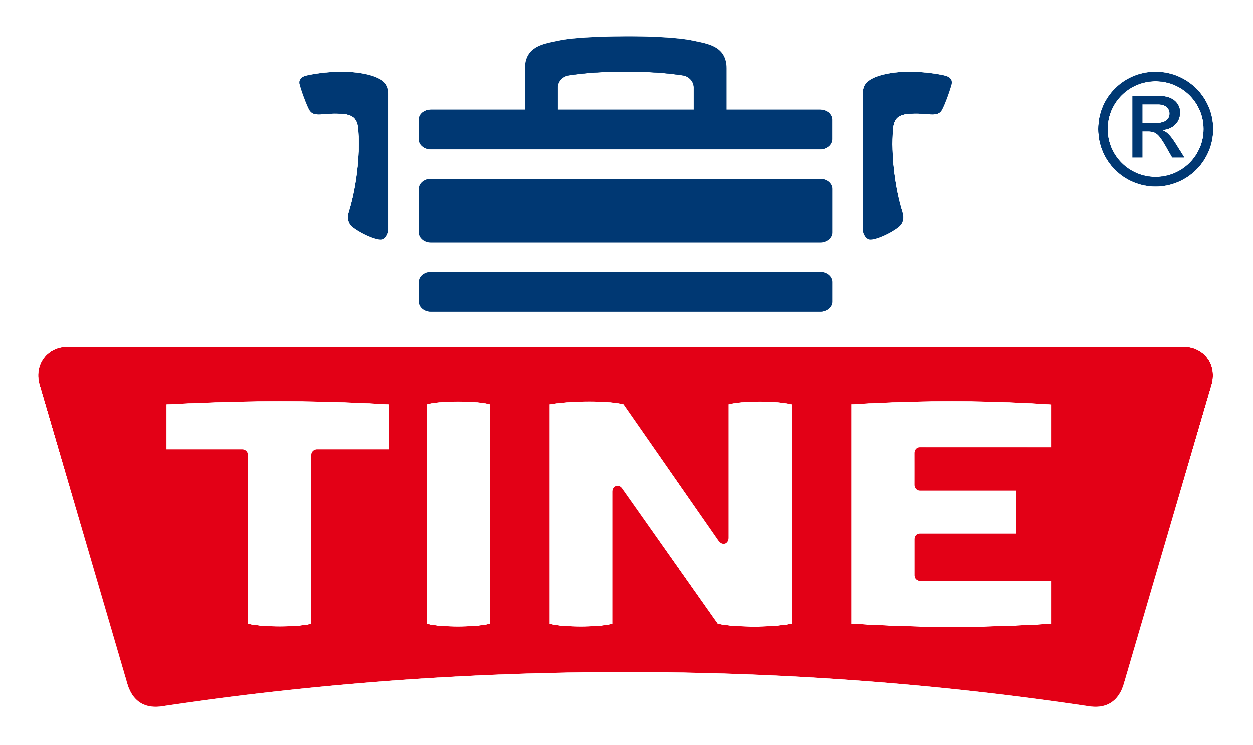









Azure Migration and Modernization Program (AMMP)
Get the right mix of resources and expert help at every stage of your cloud journey.
Proven approach: Microsoft Cloud Adoption Framework and Well Architected Framework
Free tools/ automation: Azure Migrate
In-depth assistance from FastTrack for Azure engineers
Expert help from specialized services partners
Cost-effective offers and incentives
Technical skill building
Let’s move forward together with confidence. We’re here to help at every step.
Learn more | Azure.com/AMMP
Notes:
AMMP continues to be our hero corporate program for all things migration and modernization in FY22.
In July 2021, we launched an update to program, expanding the focus on modernization and introducing new program offerings
FastTrack for Azure engineering guidance during strategy and planning stages of large projects (>$500k)
Solution Assessments are now available which offer a holistic business case to help customers develop their migration and modernization plans
Cloud Adoption Framework Workshops to help customer make key decisions during their cloud adoption journey
New Standard and Advanced offers designed to best support customer needs
Support for Azure Spring Cloud and Azure Cosmos DB
Pillars:​
A proven approach for all your needs
Optimize costs, drive sustainable outcomes
Move confidently with expert help

Slide 19
Streamlined app modernization
Most comprehensive SQL compatibility with familiar tools and languages
Always up to date version of SQL Server
Near real-time data replication from on-premises to managed Azure SQL
Automated migration tools
Notes:
Streamline application modernization with the latest SQL Server capabilities in the cloud.
SQL Managed Instance maintains the highest compatibility levels, so you can move your on-premises workloads without worrying about application compatibility or performance changes.
Because SQL Managed Instance provides an entire SQL Server instance within a managed service, you can continue to use familiar tools and SQL Server features like cross-database queries and linked server.
The link feature in SQL Managed Instance connects your SQL Servers hosted anywhere to Azure SQL Managed Instance, providing unprecedented hybrid flexibility and database mobility. With an approach that uses near real-time data replication to the cloud, you can offload workloads to read-only secondaries on Azure to take advantage of cloud-only features, performance, and scale. You can also choose to migrate one or more applications at the same time, at your own pace, with minimum downtime.
Automated tools, like Database Migration Service, reduce the complexity of your cloud migration by using a single comprehensive service instead of multiple tools.

Slide 20






Streamlined app modernization
Azure SQL Managed Instance
Hybrid flexibility and data mobility
Run Azure services anywhere
Evergreen SQL
Azure Migrate
Always up to date with the latest version of SQL Server
Never worry about patching, upgrades or end of support again
Combines the full SQL surface area with the benefits of a fully-managed service
Native VNET integration
Built-in HA with Always-on; up to 99.995% SLA out of the box
Built-in intelligent performance
Near real-time data replication to managed Azure SQL
Offload workloads to read-only secondaries and use cloud features
Migrate one or more apps at the same time, at your own pace, with minimum downtime
Stay current with the latest Azure innovations with Azure Arc enabled services.
Elastically scale based on capacity, deploy data in seconds.
Ensure consistency with unified operations, management, and security.
Centralized migration service
Comprehensive approach to migrating apps and datacenters
Discover, assess and migrate on-premises apps, infrastructure and data
Notes:
We provide the tools and capabilities necessary to help customers achieve their modernization goals:
Evergreen SQL – Azure SQL’s managed databases are evergreen, meaning they are always up to date so you never have to worry about updates, upgrades or end of support again.
Azure SQL Managed Instance - Azure SQL Managed Instance is the intelligent, scalable, cloud database service that combines the broadest SQL Server engine compatibility with all the benefits of a fully managed, intelligent and evergreen platform as a service. SQL Managed Instance provides the broadest SQL Server compatibility on a fully-managed service, so you can confidently modernize your application with minimal code changes. Built on the SQL Server code base, you can combine your experience with familiar tools, skills and resources and do more with what you already have. SQL Managed Instance also provides two levels of isolation, at the compute level and at the network level, providing a high level of isolation and security for your data.
Hybrid flexibility and data mobility - The link feature in SQL Managed Instance connects your SQL Servers hosted anywhere to Azure SQL Managed Instance, providing unprecedented hybrid flexibility and database mobility. With an approach that uses near real-time data replication to the cloud, you can offload workloads to read-only secondaries on Azure to take advantage of cloud-only features, performance, and scale. You can also choose to migrate one or more applications at the same time, at your own pace, with minimum downtime.
Run Azure services such as Azure SQL Managed Instance anywhere. With Azure Arc, you can implement cloud practices and automation to deploy faster, consistently, and at scale with always-up-to-date Azure Arc-enabled data services.
Use Azure Migrate to bring everything together and simplify cloud migration. With one centralized migration service, you can discover and assess your datacenter, and then migrate workloads to Azure. It’s a comprehensive approach to migrating your application and datacenter estate. Supports key migration workloads like Windows Server, Linux, SQL and other Databases, data with Data Box, Web Applications, and Workstations (including Virtual Desktop Infrastructure). Holistic across VMware, Hyper-V, physical server, and cloud-to-cloud migration. Discover, assess, and migrate on-premises applications, infrastructure, and data. Centrally plan and track the migration across multiple Microsoft and independent software vendor (ISV) tools.

Slide 21
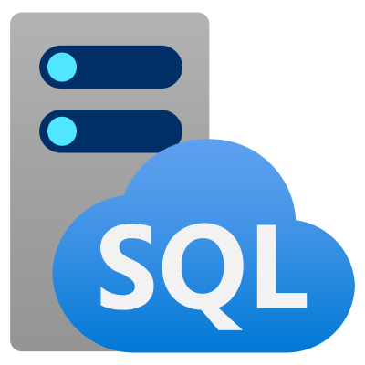
Azure SQL Managed Instance
Combine the best of SQL Server with the benefits of a fully managed service
Full SQL Server surface area
Native VNET integration provides private IP address and full isolation from other tenants without resource sharing
Always up to date
Built-in HA with Always-on
99.99% SLA out of the box
Built-in intelligent performance and security
Migrating to Managed Instance means virtually no code changes to your apps
Notes:
Azure SQL Managed Instance is the intelligent, scalable cloud database service that combines the broadest SQL Server database engine compatibility with all the benefits of a fully managed and evergreen platform as a service. SQL Managed Instance has near 100% compatibility with the latest SQL Server database engine, providing a native virtual network (VNet) implementation that addresses common security concerns, and a business model favorable for existing SQL Server customers. SQL Managed Instance allows existing SQL Server customers to modernize their on-premises applications to the cloud with minimal application and database changes. At the same time, SQL Managed Instance preserves all PaaS capabilities (automatic patching and version updates, automated backups, high availability) that drastically reduce management overhead and TCO.

Slide 22
New features recently announced at Ignite 2021
Check out what’s new with Azure SQL Managed Instance
Online replication of SQL Server databases hosted anywhere to Azure SQL Managed Instance
Support for allocation up to 16 TB of space on SQL Managed Instance in the Business Critical service tier using the new memory optimized premium-series hardware generation
Ability to authenticate legacy apps through the cloud without changing the application itself
Read this blog to learn more about what’s new with Azure SQL Managed Instance

Slide 23
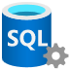
Link feature in Azure SQL Managed Instance Use modern Azure services today and migrate when you’re ready
Continuously replicate data to the cloud
Run SQL Server anywhere while immersing in Azure at your own pace.
Offload analytics from a hybrid environment before migrating to the cloud
Streamlined, non-disruptive migration experience
Test production workloads on SQL Managed Instance before migrating to the cloud
Online failover
SQL Server
Azure SQL Managed Instance
Notes:
The new link feature of Azure SQL Managed Instance connects your SQL Servers hosted anywhere (supporting SQL Server 2019 Enterprise Edition at this time, with all editions 2016 and beyond in the near future) to Azure SQL Managed Instance, providing hybrid flexibility and database mobility. With an approach that uses near real-time data replication to the cloud, you can shift workloads to read-only secondaries on Azure to take advantage of cloud-only features, performance, and scale. You can also choose to migrate one or more applications at the same time, at your own pace, with minimum downtime.

Slide 24
SQL Managed Instance is Azure Arc enabled
Key Benefits
Some scenarios may require a hybrid approach:
Always current
Access the latest Azure features and capabilities for on-premises data workloads
Data latency
Regulations
Distributed compute
Multi-cloud
Elastic scale
Dynamically scale up or out your data workloads based on capacity
Bring Azure innovation and cloud benefits on-premises, multi-cloud, and at the edge with Azure Arc enabled SQL Managed Instance
“I really like the SQL version control, which helps reduce the time that senior administrators must spend upgrading all those different versions.”
Unified management
Gain a single view of your data across on-premises and cloud environments
Kristina Melo, IT Manager, Ferguson Enterprises
Notes:
When connectivity, data sovereignty, or regulatory concerns drive a hybrid approach. Azure SQL has you covered.
SQL Managed Instance is now Azure Arc-enabled. Bring Azure data services to on-premises, multicloud, and edge environments.
Run Azure data services on-premises, at the edge, and in multicloud environments using Kubernetes on the infrastructure of your choice. Get the latest Azure innovations, elastic scale, and unified management for data workloads with or without direct cloud connection.

Slide 25
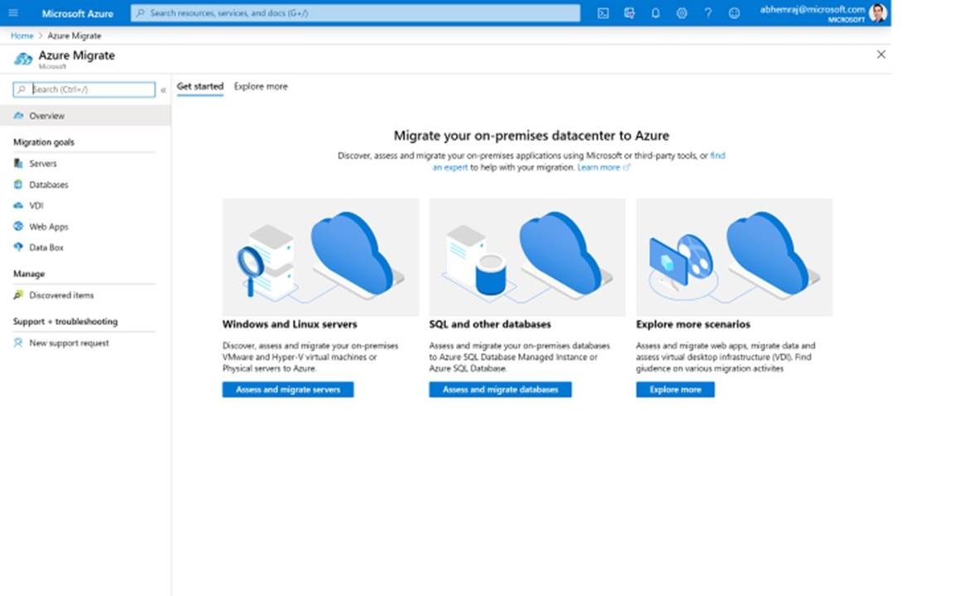
Azure Migrate: A Central Hub for Datacenter Migration
Assess and Migrate SQL Server
Assess your on-premises databases and receive a full report including the best-fit Azure SQL platform for your current environment
Multiple Scenarios
Migrate Windows and Linux Servers, Databases, Data, Web Applications and Virtual Desktops
Diverse Capabilities
Comprehensive discovery, assessment, and migration capabilities powered by Azure and third-party tools
Centralized Visibility
Centralized migration repository delivering end-to-end tracking and insights
Notes:
In the past, cloud migration was overwhelming with disconnected tools in different places.
That's why Microsoft introduced Azure Migrate to bring everything together and simplify cloud migration. With one centralized migration service, you can discover and assess your datacenter, and then migrate workloads to Azure.
Discover, assess, and migrate on-premises applications, infrastructure, and data. Centrally plan and track the migration across multiple Microsoft and independent software vendor (ISV) tools.
A comprehensive approach to migrating your application and datacenter estate. Supports key migration workloads like Windows Server, Linux, SQL and other Databases, data with Data Box, Web Applications, and Workstations (including Virtual Desktop Infrastructure). Holistic across VMware, Hyper-V, physical server, and cloud-to-cloud migration.

Slide 26
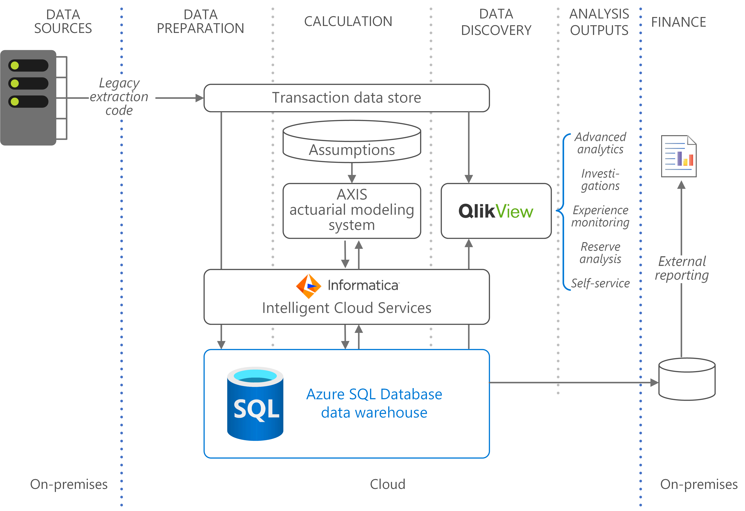

Case study Manulife future-proofs risk models on Azure using Azure SQL Database and saves a bundle
Challenge
Decades of growth and acquisitions created a costly back office patchwork that increasingly slowed down their valuation models.
Boosting compute capacity for peak load resulted in idle capacity Impact
~40% savings in hardware and labor costs switching from IaaS to PaaS
Modeling calculations now take a day or two, instead of a week
“We came from an IaaS mindset. Last year, we migrated to Azure PaaS. Now everything is automated—we integrate servers with a few clicks of a button.” Rohit Mistry: Infrastructure Analyst
Notes:
https://customers.microsoft.com/en-us/story/818907-manulife-insurance-azure-sql-database

Slide 27




Case study H&R Block enhances service delivery and scale while accelerating innovation on Azure
Data Marts
Cosmos DB
Business/custom apps
(structured)
Azure Databricks
Multiple Azure SQL managed instances
PolyBase
Relational data sources
Azure Data Factory
Azure Blob Storage /
Data Lake Gen 2
Azure Synapse
Power BI
Challenge
Unify disparate data sources to deliver seamless multichannel experiences and provide better customer service. Impact
Improved app performance and scalability to meet tax-season peaks in demand.
Unified data architecture that opens the door to advanced digital technologies using AI and machine learning.
Banking and tax aps
Files (unstructured)
“[SQL Managed Instance] gives us a smooth migration path for moving existing workloads to Azure with minimal technical reengineering.” Sameer Agarwal, Manager, Enterprise Data Analytics
Notes:
https://customers.microsoft.com/en-us/story/724156-hr-block-professional-services-azure-sql-server

Slide 28


Case study Komatsu achieves breakthrough performance and savings with Azure SQL Managed Instance
Azure
Azure Analysis Services
SQL Managed Instance
Azure ExpressRoute
Power BI
Private cloud
Dashboards
Reports
Datasets
Challenge
Need to aggregate large volumes of construction and machine data
Mainframe-based applications were outdated and siloed Impact
49% cost reduction and up to 30% performance improvements
Azure SQL Managed Instance is now the single source of truth across the business
Dynamics AX
Telemetry data
Fluid sampling
“[Azure SQL Managed Instance] was the best choice for us in terms of scalability, cost, and performance.… We’ve seen a 49 percent cost reduction and 25 to 30 percent performance gains.” Nipun Sharma: Analytics Architect, Business Technology and Systems
Notes:
https://customers.microsoft.com/en-us/story/komatsu-australia-manufacturing-azure

Slide 29


Case study SKF builds factories of the future with Azure Arc-enabled SQL Managed Instance
Azure
Azure Monitor
Azure Backup
Update Management
Arc-enabled SQL Managed Instance
Challenge
Digitalize app and data estate on existing equipment across global factories.
Data latency prevents full-scale migration to Azure
Costs and overhead from managing heterogeneous environments Impact
Cloud managed services, like Azure SQL MI, on customer infrastructure
Automation at scale with HA/DR, backup, patching
Best practice GitOps using Azure Kubernetes Services
Cost savings from standardized modern infrastructure with Azure Stack HCI
Factories
Factory 1
Factory 2
…
Factory N
“If we want to scale resources for SQL Managed Instance… we can make changes at scale, while the factory keeps the application running, uninterrupted. That's a game-changer.”
Sven Vollbehr, Head of Digital Manufacturing, SKF Group
Notes:
https://customers.microsoft.com/en-us/story/1340375893662173818-skf-azure-arc-manufacturing
“For example, if we want to scale resources for SQL Managed Instance synced with one of our factories in Italy, we can go into Azure DevOps to change the number of CPU cores that should be available, commit the changes, and it will update on the Azure Arc dashboard.” Vollbehr explains. “With Azure hybrid solutions, we can make changes at scale, while the factory keeps the application running, uninterrupted. That's a game-changer.”

Slide 30
Hyperscale demanding workloads
Limitless scale that breaks through the constraints of modern app development
Rapid scalability not impacted by the size of the data operation
Nearly instantaneous backups and fast database restores in minutes
Notes:
Hyperscale your demanding workloads and break through the resource limitations that can affect your application’s performance.
Azure SQL Database Hyperscale adapts to changing requirements by rapidly scaling storage up to 100 TB. The flexible, cloud native architecture allows storage to grow as needed and enables nearly instantaneous backups and fast database restores in minutes instead of hours or days—regardless of the size of the data operation.

Slide 31
Unmatched scale with Azure SQL Database Hyperscale
Highly scalable storage
High performance
Reliable and available
Auto-scales quickly up to 100TB
Compute and storage scale independently without sacrificing performance
Operations perform in constant time, regardless of the data operation size
Low latency, high throughput for large databases
Snapshot-based backups – no impact on query performance
Rapid database restore
Multiple levels of redundancy
No single points of failure
99.95% availability SLA
Notes:
Hyperscale is a highly scalable, performant and available service tier in Azure SQL Database that leverages the Azure architecture to scale out the storage and compute resources for an Azure SQL Database substantially beyond the limits available in other SQL Database service tiers.
SQL Database Hyperscale provides the following capabilities:
Support for up to 100 TB of database size
Rapid scale out - you can provision one or more read-only nodes for offloading your read workload and for use as hot-standbys
Rapid Scale up - you can, in constant time, scale up your compute resources to accommodate heavy workloads as and when needed, and then scale the compute resources back down when not needed.
Nearly instantaneous database backups (based on file snapshots stored in Azure Blob storage) regardless of size with no IO impact on compute resources
Fast database restores (based on file snapshots) in minutes rather than hours or days (not a size of data operation)
Higher overall performance due to higher log throughput and faster transaction commit times regardless of data volumes
Azure SQL Database Hyperscale is reliable and available, providing an availability guarantee of at least 99.95% with one replica and 99.9% for zero replicas.

Slide 32








Case study BMI uses Azure to efficiently manage data at scale when distributing royalties to its affiliates
BMI
App service plan
Web apps
Azure Cognitive Search
Azure SQL Database Hyperscale
Web jobs
Power BI
Challenge
Needed a scalable way to process growing volumes of data from the digital music market.
Mainframe database too expensive and time consuming to upgrade. Impact
Improved scalability, reduced database costs, and increased automation, operational and technical teams now invest in other activities.
Processing time improvements by a minimum of 20% - and several hundred percent in some areas.
On-premises datacenter
Azure Data Factory
Azure Blob Storage
Azure Databricks
“With Hyperscale, we can scale up compute in less than two minutes, whether it’s a 10-gigabyte database or a 10-terabyte database. The less time we spend on maintenance and index builds, the more time our staff have to run processing jobs.” Greg Walrath: Executive Director of Enterprise Architecture
Notes:
https://customers.microsoft.com/en-us/story/847390-bmi-media-entertainment-azure

Slide 33





Case study ClearSale builds foundation for growth and innovation with Azure SQL Database Hyperscale
Change data capture
Event Hub
Functions
Read/write
Read Replicas
Automated Analysis
ADF/Airflow
ML models
Decision rules
Status updates
Orchestration
SQL Server on-premises
Challenge
Inability to scale enough from its Rackspace-hosted environment to meet demand.
Too much time spent on manual provisioning and patching Impact
Ability to scale up to manage 30% more transactions
Database backups and restores in minutes
Can now scan, validate and generate transaction recommendations in less than 500 milliseconds
Analysts
Control database
Different Hyperscale DBs based on clients/domains
Databricks
“Working in the Azure SQL Database Hyperscale tier helps us streamline upgrades to new and existing applications, and with instant, unlimited scaling, customers can rely on us when it counts.” Jelther Gonçalves, Data Engineer
Notes:
https://customers.microsoft.com/en-us/story/773410-clearsale-partner-professional-services-azure

Slide 34
Optimize price-performance with serverless compute
Flexible cost models to suit both consistent and unpredictable workloads
Automatic compute scaling operates at the true rhythm of your business
Optimize price-performance for your unique workloads
Notes:
Build modern apps your way with flexible provisioned and serverless compute cost models that help you optimize price-performance for your unique workloads.
Azure SQL Database serverless simplifies performance management and helps developers focus on building apps faster and more efficiently with compute resources that automatically scale based on workload demand.
SQL Database serverless is best for scenarios where usage is intermittent and unpredictable and you only pay for compute resources you use on a per-second basis, optimizing overall price-performance.

Slide 35
Optimize price-performance with serverless
Cost-effective
Pay for performance. Period
Automatic scaling
Operate at the true rhythm of your business
Fully managed & intelligent
Focus on your apps, not your infrastructure
Pay only for compute resources you consume, on a per-second basis
Further optimize costs with configurable compute thresholds
Adapts compute resources to the workload without sacrificing performance
Automatically pauses and resumes
Fully-managed and intelligent database service
Built-in 99.99% availability
Notes:
Azure SQL Database serverless is our answer to cost-effectively resourcing unpredictable and intermittent workloads. It is a dynamically scaling, on-demand version of Azure SQL Database that eliminates the complexity of resourcing and managing unpredictable workloads. Simply create a serverless database and connect your application, with no upfront resource configuration required.
With resources available on-demand, serverless SQL databases optimize costs with pay per-second billing that aligns with the app’s performance, so you only pay for the compute resources you use.
Serverless SQL databases automatically pause, resume and scale compute based upon your app’s requirements, making them particularly cost effective for variable or unpredictable workloads – or when you’re simply unsure of your requirements. When the database is paused, you only pay for the storage.
Built upon the SQL Server architecture, serverless SQL databases are fully-managed, always up to date and highly available with a 99.99% uptime guarantee. Combined with built-in intelligence to optimize database performance and security, serverless SQL Databases help you be more productive so you can focus more on what you do best, building great apps faster and more cost effectively.

Slide 36




Case study Analytics SaaS provider scales instantly, delivers faster and more cost-efficient service to customers using serverless computing
Data Sources
ETL
Data Storage
Visualization
ERP 1
ERP 2
Azure Data Factory
Azure SQL Database serverless
Azure Functions
Power BI
Challenge
Wanted to optimize data processing performance but not pay for high compute power when it didn’t need as much. Impact
Customer cost savings up to 15x
Increased development team’s efficiency by minimizing performance management of its databases
Pays only for the compute resources it needs
Enables near real-time analytics to meet customer demand
ERP 3
“We’re keeping costs low while ensuring good performance by using SQL Database serverless. Depending on a customer’s usage pattern, the cost savings for production workloads can be as high as 15 times.” Mathieu Viau: President and Cofounder

Slide 37
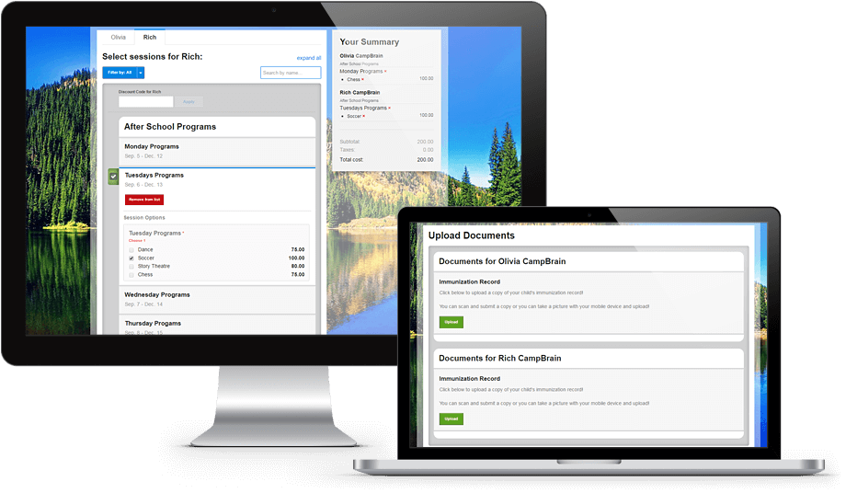



Case study Camp management software provider is always prepared with Azure SQL Database serverless
Azure App Services
Customers
Camp management SaaS app
Challenge
Unpredictable spikes in usage volumes
Managing compute costs
Planning for the peak loads
Impact
Uninterrupted service for customers
Up to 60% cost saving reduction
Time saving with no need to plan for peak loads
Azure SQL Database serverless
“Azure SQL Database serverless is easy to manage, and it just works—without any change to the security model, to access, or any other environmental controls.” Michael Aird, Chief Technology Officer, CampBrain
Notes:
https://customers.microsoft.com/en-us/story/779861-campbrain_professionalservices_azure_canada

Slide 38
Build modern, intelligent apps faster
Scale multiple databases across shared resources
Build on common platforms using familiar tools, with driver support for the most popular languages
Meet today’s demanding application requirements with multi-model flexibility
Notes:
Azure SQL Database elastic pools provide SaaS developers resource sharing across multiple databases to help reduce costs and management complexity.
Develop on popular platforms including Windows, Linux, and Mac with familiar tools like Visual Studio and Azure Data Studio.
Build on what you know with driver support for all the most common languages such as .NET, C#, Java, Python, Node.js, PHP and Go.
Efficiently meet the needs of today’s demanding applications with multimodel capabilities that leverage graph processing, JSON data, OPENXML, spatial, OPENJSON, and XML indexes

Slide 39
Build modern, intelligent apps faster
Azure SQL Database elastic pools
Optimize price-performance for multiple databases
Popular platforms and languages
Build on what you know
Multi-model flexibility
Single database support for your apps
Cost-effective solution for managing multiple databases with varying usage patterns (ie multi-tenant SaaS apps)
Pools automatically scale performance and storage capacity for elastic databases
Develop on popular platforms like Windows, Linux and Mac
Use familiar tools like Visual Studio and Azure Data Studio
Driver support for common languages like .NET, C#, Java, Python, Node.js, PHP and Go
Store and work with data in multiple formats
Support for graph, JSON or XML documents, spatial data, and key-value pairs
Notes:
Azure SQL Database elastic pools are a simple, cost-effective solution for managing and scaling multiple databases that have varying and unpredictable usage demands. The databases in an elastic pool are on a single server and share a set number of resources at a set price.
Develop on popular platforms including Windows, Linux, and Mac with familiar tools like Visual Studio and Azure Data Studio. Build on what you know with driver support for all the most common languages such as .NET, C#, Java, Python, Node.js, PHP and Go.
Efficiently meet the needs of today’s demanding applications with multimodel capabilities that leverage graph processing, JSON data, OPENXML, spatial, OPENJSON, and XML indexes.

Slide 40

Azure SQL Database
Build apps that scale with the pace of your business with managed and intelligent SQL in the cloud
Combining the best of SQL Server with the benefits of a fully-managed, intelligent service
Fully managed and always on the latest version of SQL
Hyperscale your most demanding workloads
Optimize costs with serverless compute that scales automatically
Build and deliver modern, intelligent apps faster with multi-model capabilities and support for popular languages and frameworks
Save with the best total cost of ownership
Notes:
Part of the Azure SQL family, Azure SQL Database is an intelligent, scalable, relational database service built for the cloud. Optimize performance and durability with automated, AI-driven features that are always up to date. Focus on building new applications without worrying about storage size or resource management with serverless compute and Hyperscale storage options that automatically scale resources on demand.

Slide 41
Flexibility to work your way
Platforms
Develop with your choice of popular platforms including Windows, Linux, and Mac
Tools
Use Azure Management Portal with HTML5 support, PowerShell, REST APIs, SQL Server Management Studio, Azure Data Studio and Visual Studio
Languages
Develop with a choice of popular languages, such as C#, Java, Node.js, Ruby, PHP, and Python
Frameworks
Leverage popular frameworks including Entity, Hibernate ORM, Ruby on Rails, and Django
Your Azure solution
Build secure apps that connect with the languages and platforms you prefer
App
T-SQL
Java
C/C++
C#/VB.NET
PHP
Node.js
Python
Ruby
Notes:
With Azure, you can build secure apps that connect with the languages and platforms you prefer.
Seamlessly develop apps on or offline and across on-premises and cloud-designed apps with Visual Studio. Extend existing applications to the cloud with DAC framework support.
Develop with your choice of popular platforms, including Windows, Linux, and Mac, with familiar tools such as the Visual Studio integrated dev environment and SQL Server Management Studio.
Improve productivity with the Azure Management Portal with HTML5 support, PowerShell, and REST APIs. Use popular languages, such as C#, Java, Node.js, Ruby, PHP, and Python, and popular frameworks, including Entity, Hibernate, Ruby on Rails, and Django.

Slide 42
Programmatic capabilities
Develop with a choice of popular platforms and technologies, including .NET, Java, PHP, Ruby on Rails, and Node.js
Platforms
Query JSON using standard T-SQL syntax; use JSON with all components of Azure SQL Database, such as In-Memory OLTP
JSON support
Keep a full history of all changes made to table; use for easy point-in-time restore or calculate trends over time
Temporal tables
T-SQL editor
Use the HTML5-based T-SQL editor in Azure Management Portal
Notes:
Objective: A variety of platforms can be used to work with Azure SQL, which allows developers to leverage their current skill sets and be productive faster.
Talking Points:
JSON is a popular textual data format used for exchanging data in modern web and mobile applications. JSON is also used for storing unstructured data in log files or NoSQL databases like Microsoft Azure DocumentDB. Many REST web services return results formatted as JSON text or accept data formatted as JSON. Most Azure services, such as Azure Search, Azure Storage, and Azure DocumentDB, have REST endpoints that return or consume JSON. JSON is the main format for exchanging data between web pages and web servers using AJAX calls. SQL Server provides built-in functions and operators that enable you to parse JSON text and read or modify values, transform arrays of JSON objects into table format and use any Transact SQL query on the converted JSON objects, and format results of Transact-SQL queries in JSON format.
SQL Server 2016 introduces support for system-versioned temporal tables as a database feature that brings built-in support for providing information about data stored in the table at any point in time rather than only the data that is correct at the current moment in time.
Use the Transact-SQL (T-SQL) editor to author and execute database queries, modify database objects and scripts, view scripts that update database schemas or data, and author database unit tests.

Slide 43
Save with the best total cost of ownership
Operational and financial benefits, up to 17% lower TCO over SQL VM and +$30M add’l revenue over 3 years¹
Use SQL Server licenses with Azure Hybrid Benefit to save up to 55% off full price²
Meet mission-critical requirements while costing up to 86% less than the competition³
¹ Results are based on interviewed customers. “The Economic Value of Migrating On-premises SQL Server Instances to Microsoft Azure SQL Solutions,” a commissioned study conducted by The Enterprise Strategy Group on behalf of Microsoft, October 2020.
² Savings based on eight vCore Managed Instance Business Critical in East US Region, running 730 hours per month. Savings are calculated from full price (license included) against base rate (applying Azure Hybrid Benefit for SQL Server), which excludes Software Assurance cost for SQL Server Enterprise edition, which may vary based on EA agreement. Actual savings may vary based on region, instance size and performance tier. Prices as of December 2017, subject to change.
³ Price-performance claim based on data from a study commissioned by Microsoft and conducted by GigaOM in August 2019. The study compared price performance between a single, 80 vCore, Gen 5 Azure SQL Database on the business critical service tier and the db.r4.16xlarge offering for SQL Server on AWS RDS. Benchmark data is taken from a GigaOM Analytic Field Test derived from a recognized industry standard, TPC Benchmark™ E (TPC-E), and is based on a mixture of read-only and update intensive transactions that simulate activities found in complex OLTP application environments. Price-performance is calculated by GigaOm as the cost of running the cloud platform continuously for three years divided by transactions per second throughput. Prices are based on publicly available US pricing in East US for Azure SQL Database and US East (Ohio) for AWS RDS as of August 2019. Price-performance results are based upon the configurations detailed in the GigaOM Analytic Field Test. Actual results and prices may vary based on configuration and region.
Notes:
Save with the best total cost of ownership on Azure SQL.
Azure SQL Database and Azure SQL Managed Instance are fully managed, evergreen services that are always up to dates with the latest SQL features and functionality. Boost productivity and operate more efficiently by letting the services perform time-consuming and complex tasks on your behalf. Features like built-in high availability, disaster recovery and automated backups ensure your data is available when you need it, while AI-powered automatic tuning optimizes performance for you.
According to an Enterprise Strategy Group report commissioned by Microsoft, organizations can realize up to a 47% TCO savings from migrating from on-premises to SQL on Azure VM. Modernizing on Azure SQL managed databases provided an additional 17% TCO savings through lower application and systems administration costs and incremental revenue from accelerated release cycles.¹
Unique offers like Azure Hybrid Benefit for SQL Server help maximize the value from your current licensing investments. Use your SQL Server licenses with Software Assurance and save up to 55 percent over pay-as-you-go pricing on SQL Database and SQL Managed Instance.²
Azure SQL Database also helps you optimize costs with leading price-performance that costs up to 86% less than the competition.
¹ Results are based on interviewed customers. “The Economic Value of Migrating On-premises SQL Server Instances to Microsoft Azure SQL Solutions,” a commissioned study conducted by The Enterprise Strategy Group on behalf of Microsoft, October 2020.

Slide 44
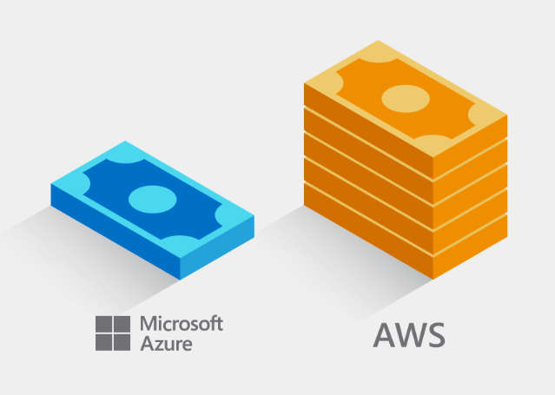
Key offers lower your total cost of ownership
AWS is 5x more expensive than Azure
Azure Hybrid Benefit
Maximize existing investments in on-premises licenses with discounted rates, up to 55% vs pay-as-you-go, on Azure SQL Database and Azure SQL Managed Instance.
Reserved Capacity
Prepare Azure SQL Database resources in advance and save up to 33%. Combine with Azure Hybrid Benefit for savings up to 80%.
Dev/test pricing
Save up to 55% versus list prices, eligible with active Visual Studio subscriptions.
Azure vs. AWS homepage
5x substantiation page
Notes:
Key offers lower your total cost of ownership
Azure Hybrid Benefit for SQL Server - Significantly reduces migration costs by using on-premises SQL licenses (with active Software Assurance) for discounted rates in the cloud.
Azure-only benefit provides up to 55% savings vs pay-as-you-go pricing, and up to 59% savings vs AWS
Available to customers with SQL Server licenses and active Software Assurance
Unique benefit for highly virtualized workloads, providing 4 vCores of SQL Database General Purpose in the cloud for every 1 on-premises core in SQL Enterprise Edition.
Reserved capacity pricing – Improve budget and forecasting by prepaying for 1 or 3-year terms with reserved capacity pricing.
Discounted rates up to 33% for 1- or 3-year term commitments
Combine with Azure Hybrid Benefit for up to 80% savings off license-included rates
Exchange or cancel reservations
Scale up or down within a tier with auto-fit
Dev/test pricing - Discounted rates up to 55% off license-included to support ongoing development and testing. Eligible with active Visual Studio subscription.

Slide 45


Case study Education solution provider ascends to the cloud with zero user impact, reduces costs by 70 percent
Application
Web server
Challenge
Replace 35 aging on-premises Oracle servers without service disruption
Breaking free of recurring server replacement costs
Existing systems could not scale to meet growing demand
Impact
Migrated 4 TB overnight with zero disruption
Reduced its operating costs by 70 percent
Accelerated development time
Focused on innovation, not datacenter maintenance
Azure SQL Database
Batch server
“We’ve reduced our operating costs by about 70 percent or one-seventh of our previous IT budget. We’re using those savings to focus on research and development to make our product better and faster.” Shoji Ueda, Senior Architect, Benesse
Notes:
https://customers.microsoft.com/en-us/story/732188-benesse-education-azure-sql-database

Slide 46
Built upon an intelligent, secure and reliable foundation
Built-in AI
Advanced data security
Always On reliability
Automatic tuning continuously improves performance and optimizes resource usage
Intelligent query processing improves workload performance with minimal implementation effort
Intelligent insights detects disruptive events and analyzes performance degradations
Advanced threat protection detects anomalous database activities that could pose threats
Vulnerability assessment discovers potential gaps and provides remediation steps
SQL Database ledger enables tamper-evident, cryptographic verification
Meets the most stringent compliance standards
Built-in high availability with auto-failover groups powered by Always On technology
Industry-leading availability SLA up to 99.995% for zone-redundant deployments
Automated backups and point-in-time restore up to 35 days
Notes:
Azure SQL’s managed databases are built on an intelligent, secure and reliable foundation
Built-in AI
Azure SQL Database and Azure SQL Managed Instance use AI-powered features to optimize performance and security on your behalf. These technologies have been present for years and have been proven in practice on real customer cases. Usage at scale, with real workloads is what is essential to train and improve these technologies to make them truly effective. Some of the more popular features automatically tune your databases and queries and provide insights into disruptive events that degrade performance. Features such as:
Automatic tuning:
Provides peak performance and stable workloads through continuous performance tuning based on AI and machine learning. In addition to performance tuning, the feature will also automatically verify performance gains and initiate rollback and self-correction, if necessary.
Intelligent query processing:
This family of features improves the performance of existing workloads with minimal implementation effort to adopt.
Intelligent Insights:
Intelligent Insights uses built-in intelligence to continuously monitor database usage through AI and detect disruptive events that cause poor performance. Once detected, a detailed analysis is performed that generates an Intelligent Insights resource log (called SQLInsights) with an assessment of the issue. This assessment consists of a root cause analysis of the database performance issue and, where possible, recommendations for performance improvements.
Advanced Data Security
Benefit from multi-layered security provided by Microsoft across physical datacenters, infrastructure and operations and protect your databases with fine-grained access controls, Always Encrypted technology and advanced data security features like:
Microsoft Defender for SQL constantly monitors for known vulnerabilities and threats:
Advanced threat protection:
Provides a new layer of security to your database by detecting anomalous database activities that can indicate a common threat, such as injection attacks. It provides:
Simple configuration of threat detection policy via Azure Portal.
Clear email alerts upon detection of suspicious databases queries indicating potential injection events.
Ability to explore the audit log around the time of the event by using the Azure Portal or preconfigured Excel template.
No need to modify database procedures or application code.
Vulnerability assessment:
Provides visibility into the security state of your database system and allows you to continuously track and improve it over time. It:
Discovers sensitive data which is not protected
Identifies security misconfigurations that could leave your database vulnerable to attack
Provides clear remediation steps for each issue found, including customized scripts to just click and run, and click-to-fix solutions.
SQL Database ledger:
Ledger capability is now supported on SQL Database, enabling tamper-evidence through cryptographic verification for your centralized data stores. Ledger eliminates the additional cost, complexity, and performance overhead of decentralized blockchain technology while providing many of the benefits of blockchain in a fully managed and familiar SQL environment.
Get cloud compliance with the broadest set of offerings with more than 90 compliance certifications.
Always On reliability
When data is the lifeblood of your business, you want to ensure your databases are reliable, secure, and available when called upon to perform. Azure SQL Database and Azure SQL Managed Instance provide built-in high availability with auto-failover groups that ensure data is never lost due to failures. Automated backups and point-in-time restore backups protect your data from accidental corruption or deletion and enable you to access backups up to 35 days old.

Slide 47













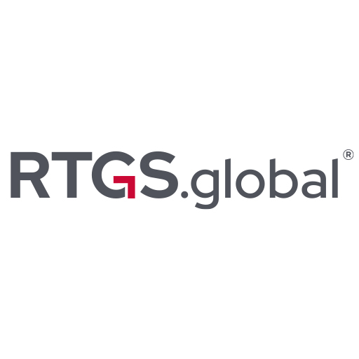
Case study RTGS.global automates financial transfers, unlocks trillions in capital with Azure
Industry Data Workbench
RTGS.global – Global Hub
Databricks
Subscription
Key Vault
Azure AD
Monitor
Azure Data Explorer Clusters
Event Grid
Consumer
RTGS.global – Regional Hub
User mgmt
Key Vault
DPKI Services
RTGS.global Network Connector
Global Sub
Central Bank / Regulator Azure Subscription
Regulatory Event Domain
Config Store
Industry Data Workbench
Azure Cosmos DB
Key Vault
Databricks
Databricks
Regulatory Event Topics
Challenge
Building and maintaining private blockchains too expensive and time-consuming.
Too much time spent on manual provisioning and patching.
Impact
Saved hundreds of hours that would have been required to develop and manage its own blockchain
Enabled faster payments, freed trillions of dollars of capital
Provided better experiences to banks and their customers
Subscription
Event Grid
User mgmt
Key Vault
DPKI Services
Application Gateway
AKS SOA micro-services
Azure SQL Database ledger
RTGS.global Network Connector
Participating Bank Azure Subscription
“We needed a private, highly secure platform that can instantly send messages across jurisdictions. With Azure SQL Database ledger, it’s simple for us to build immutable records in a centralized SQL data estate.” Chris Sewell, Vice President of Engineering
Notes:
https://customers.microsoft.com/en-us/story/1379614319255768839-rtgs-partner-professional-services-azure-sql

Slide 48


Deployment options on Azure SQL managed databases
Azure SQL Database
Azure SQL Managed Instance
Database scoped deployments
Instance scoped deployments
Single database
Simplest database scoped model provides resource guarantees.
Elastic pool
Shared resource model lowers TCO of multi-database environments
Single instance
Instance pool
Simplest instance scoped model with broadest SQL Server compatibility and full PaaS benefits
Shared resource model lowers TCO of multi-instance environments
Best for modern cloud born apps requiring the most management simplicity
Best for multi-tenant SaaS apps requiring database isolation per tenant
Best for modernization of large single instance environments
Best for modernization of smaller multi-instance environments
Notes:
There are two different hosting options within Azure SQL Database and Azure SQL Managed Instance: a single database or instance and a pool of databases or instances. Each option is optimized for a particular scenario.
Azure SQL Database
Single database, assigns a certain amount of resources via performance tiers and focuses on a simplified database-scoped programming model and applications with a predictable pattern and relatively stable workload. It is best for modern cloud-born apps requirement the most management simplicity. The single database option is available with provisioned or serverless compute.
Elastic pool is a shared resource model that enables higher resource utilization efficiency, with all databases within an elastic pool sharing predefined resources. This option focuses on a simplified database-scoped programming model for multi-tenant SaaS apps. The workload pattern is well-defined and is highly cost-effective in multi-tenant scenarios. For ISVs with SaaS apps, the savings can be significant, in the hundreds of thousands of dollars or more.
Azure SQL Managed Instance
Single instance, assigns a certain amount of resources via performance tiers and focuses on a simplified instance-scoped programming model with the broadest SQL Server compatibility and the benefits of a fully-managed service. The single instance is best for modernization of large single instance environments.
Instance pool, provide a convenient and cost-efficient way to migrate smaller instances to the cloud at scale. Previously, in order to migrate to a single instance in the cloud, smaller, less compute-intensive workloads would often have to be consolidated. This typically required careful capacity planning, additional security considerations and some extra data consolidation work at the instance level. Instances pools bypasses this by pre-provisioning compute according to your requirements (ie 8 vCores), then enabling you to migrate instances up to your pre-provisioned compute level (ie two 2-vCore and one 4-vCore instances). You can increase or decrease the amount of compute resources available to the pool at any time. Instances within the pool are isolated, eliminating the “noisy neighbor” in cases of multi-tenant SaaS apps, and do not share resources with other instances in the pool, ensuring predictable performance at all times.

Slide 49
Flexible resource purchasing and provisioning
Select the purchasing model and compute provisioning that align to your requirements
Purchasing model
Compute provisioning
vCore model Independent scalability
DTU model Fixed scalability
Serverless
Pre-provisioned
Compute
Compute
Compute
Compute
Storage
Storage
Time
Time
Independent scaling of compute, storage and IO resources
Database Transaction Units (DTU) bundle compute, storage and IO resources
Adapts compute resources to the workload without sacrificing performance, billed on a per-second basis
Provision compute resources upfront, billed on an hourly basis
Best for workloads with regular and substantial compute utilization OR
multiple databases with bursty usage patterns that can be consolidated into elastic pools for better price optimization
Best for customers who value flexibility, control and transparency
Best for customers who want simple, pre-configured resource options.
Best for unpredictable and intermittent workloads on single databases.
Notes:
Database Transaction Unit (DTU) vs. vCore model
DTUs are pre-packaged units that represents the database power and are designed for predictable performance
vCores divides the DTU model into separate parts so that users can select and manage compute and storage independently
Serverless vs. provisioned compute
Serverless automatically scales compute based on workload demand and bills for the compute used per second
Serverless is ideal for unpredictable and intermittent workloads
Provisioned compute provides a fixed amount of compute for a fixed price billed hourly
Provisioned is suited for more regular usage patterns or multiple databases using elastic pools

Slide 50
Match performance to your workload requirements
The vCore-based model includes three options differentiated by the level of HA and storage performance.
Choose from three tiers in the vCore-based model
 | General purpose | Hyperscale | Business critical
Best for | Most budget-oriented workloads | Workloads with highly scalable storage and read-scale requirements | Workloads with high I/O requirements
Compute tiers | 2-80 vCores | 2-80 vCores | 2-128 vCores
Storage | Premium remote storage 32GB – 16TB per instance | Flexible, auto-scaling of up to 100TB of storage | Local SSD storage 32GB – 16TB per instance
Notes:
We’re committed to customer choice and as such, the DTU-based model and vCore-based models are both available to Azure SQL Database, offering simplicity and flexibility when it comes to resource management and pricing. The DTU-based model is not available in Azure SQL Managed Instance.
The vCore-based model includes three options, differentiated by the level of HA and storage performance required by your workload. These three options are General Purpose, Hyperscale and Business Critical.
General Purpose is great for most business workloads. It offers budget-oriented, balanced and scalable compute and storage options.
Hyperscale is best for data applications with large data capacity requirements and the ability to auto-scale storage and scale compute fluidly.
Business Critical is great for business applications that have high IO requirements. It offers the highest resilience to failures using 3 isolated AlwaysON replicas with one read-scale.
Within these options, pricing is based upon the number of vCores and storage and whether the license is included or if you’re using the Azure Hybrid Benefit for SQL Server to maximize your on-premises license investment.

Slide 51
How to pick Azure SQL models and service tiers
HTAP / Data Marts
OLTP
Rehosting
User needs
Rehosting and/or can tolerate 80 vCore and 100TBs
Fast provisioning and scalability
Optimize price-perf for intermittent and unpredictable workloads
Shared resource consumption for multi-tenant support
High compatibility with SQL Server and native VNET support
Migrate smaller instances to the cloud at scale
Maintain control over O/S, patching, scaling, HADR
Programming model and management control
Single database
Serverless
Single database
Elastic pool
Single instance
Instance pool
SQL Server on Azure VM
Service tier (Data size and HA)
Hyperscale
General purpose
Business critical
Hyperscale
General purpose
General purpose
Business critical
General purpose
Business critical
General purpose
Business critical
SQL Server on Azure VMs
100 TB
Read-scale cluster
99.99% HA
4 TB
Storage replication
99.99% HA
4 TB
Always On
99.995% HA
100 TB
Read-scale cluster
99.99% HA
4 TB
Storage replication
99.99% HA
4 TB
Storage replication
99.99% HA
8 TB
Always On
99.995% HA
16TB
Storage replication
99.99% HA
16 TB
Always On
99.995% HA
8TB
Storage replication
99.99% HA
4 TB
Always On
99.995% HA
64 disks
80K IO, 800 MBps
Note: Support IoT edge scenarios with Azure SQL Edge

Slide 52
Azure SQL managed databases take your workloads and apps to the next level
Streamlined app modernization
Hyperscale demanding workloads
Optimize price-performance with serverless compute
Save with the best total cost of ownership

Slide 53

More reasons to pick Azure over AWS for SQL Server workloads
Free support for SQL Server 2008/R2
Get free extended security updates for SQL Server 2008/R2 images in Azure IaaS for three years.
Best total cost of ownership
Save up to 88% on Azure SQL Database compared to AWS RDS
Automatic security updates
Ease of maintenance with automatic application of the latest security patches, only on Azure.
Evergreen SQL
Stay always up to date with Azure SQL Database, with full parity based on 100% code consistency
Pre-configured cloud backup
Restore to a specific point in time with an automatically-generated Azure backup.
Industry’s highest SLA on Azure SQL Database
Experience up to a 99.995% availability SLA and the industry’s first 100% business continuity SLA
Free Disaster Recovery secondary in Azure
On-premises SQL Server with Software Assurance now comes with free SQL license for Azure DR secondary
ML-based performance and security
Optimize performance and security with built-in, ML-based features that act on your behalf
Only cloud with Developer edition
Access the fully-featured free SQL Server Developer edition, only pre-configured on Azure.
Operational freedom
Bring Azure innovation and cloud benefits to on-premises and multi-cloud with Azure Arc-enabled data services

Slide 54
Your SQL Server data belongs on Azure
Azure SQL Database vs. AWS RDS
TPC-E Equivalent Benchmark
October 2019
Azure SQL Managed Instance vs SQL Server on AWS RDS
MSOLTPE Benchmark, 16 vCore SQL MI vs AWS RDS db.r5b.4xlarge
April 2022
SQL Database is the best choice for mission-critical SQL Server workloads
Principled Technologiespublished a study where they tested throughput performance between Azure SQL Managed Instance and SQL Server on AWS RDS across three workloads
SQL Managed Instance emerged as the price-performance leader for mission-critical workloads while costing up to 93 percent less than AWS RDS¹
Read the report to see how SQL Managed Instance performed in the other two workloads
Price/Transactions per second (tps)
93% LESS
Price performance comparison. Lower is better.
Includes Azure Hybrid Benefit
Source: Principled Technologies
¹ Price-performance claims based on data from a study commissioned by Microsoft and conducted by Principled Technologies in April 2022. The study compared performance and price performance between a 16 vCore, 64 vCore and 80 vCore Azure SQL Managed Instance using premium-series hardware on the business-critical service tier and the db.m6i.32xlarge, db.r5b.4xlarge and db.r5b.16xlarge offerings for Amazon Web Services Relational Database Service (AWS RDS) on SQL Server. Benchmark data is taken from a Principled Technologies report using recognized standards, HammerDB TPROC-C, HammerDB TPROC-H and Microsoft MSOLTPE, a workload derived from TPC-E. The MSOLTPE is derived from the TPC-E benchmark and as such is not comparable to published TPC-E results, as MSOLTPE results do not comply with the TPC-E Specification. The results are based on a mixture of read-only and update intensive transactions that simulate activities found in complex OLTP and analytics application environments. Price-performance is calculated by Principled Technologies as the cost of running the cloud platform continuously divided by transactions per minute or per second throughput, based upon the standard. Prices are based on publicly available US pricing in South Central US for Azure SQL Managed Instance and US East for AWS RDS as of April 2022 and incorporates Azure Hybrid Benefit for SQL Server, excluding Software Assurance and support costs. Performance and price-performance results are based upon the configurations detailed in the Principled Technologies report. Actual results and prices may vary based on configuration and region.

Slide 55

Get started today!
Web pages
Azure SQL family
SQL Server on Azure Virtual Machines
Azure SQL Managed Instance
Azure SQL Database
Azure SQL Edge
Choose Your Azure SQL database tool
Azure Hybrid Benefit for SQL Server
Azure Database Migration Service
Migration guide
Other Resources – infographics
Infographic: Azure SQL family
Azure SQL Jumpstart Guide
Infographic: Forrester Consulting Total Economic ImpactTM study
3rd party studies
ESG Economic Value report on migrating to Azure SQL
Principled Technologies price-performance study
Forrester Consulting Total Economic Impact™ study

Slide 56

Thank You.
© Copyright Microsoft Corporation. All rights reserved.

